Slide 1


Helpcare
Nisarga Venkatesh
Banish Mukati Ganesh
JC Namitha

Slide 2
Contents
Introduction
Project Objective
Special feathures
Model
Class Diagram
Object Diagram

Slide 3
Introduction
HelpCare is automated according to the daily operations of Hospitals
Every health care system has its pros and its cons, due to the fact that healthcare in itself will never be perfect.
Emergency Medical Services are considered as one of the services that devoted to available early

Slide 4
Project Objective
CRUD to all admins by system admin
All Admins have their own CRUD operations at their Enterprise level
New person can register to the hospital and bok an appointment
Person can be able to call for an emergency by SoS and acknowledgement is sent to doctor
Patients can opt for Insurance based on the plan

Slide 5
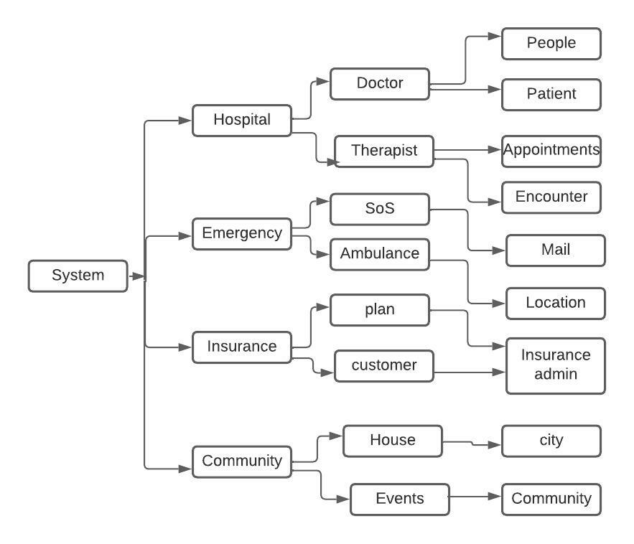
Model

Slide 6
Special Features
Email confirmation to SOS
Google Location

Slide 7
Class Diagram

Slide 8
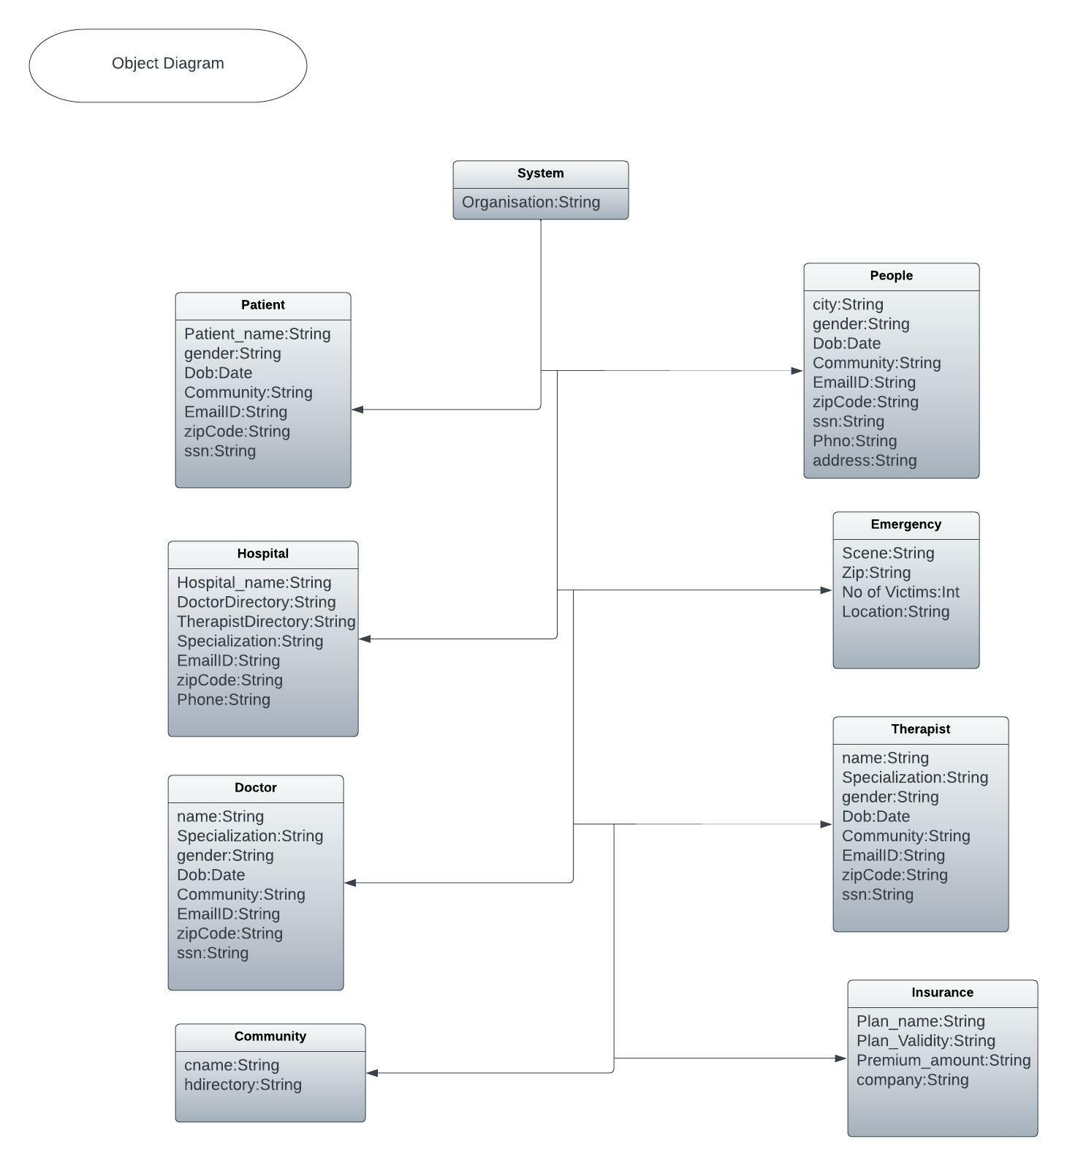
Object Diagram

Slide 9
Thank you

